Slide 1
The English Diet
Victoria Mullen

Slide 2
History of the British Diet
Prehistoric Times: Native fish, animals, and plants
Roman Empire: wheat and oats to make bread
Vikings: smoked fish and rye bread
Caribbean: coffee, tea, sugar, bananas, and rum
India: curries in the 18th century
World War I and II: rationing food and gardening
Mediterranean Europe: unsaturated fats, such as olive oil

Slide 3
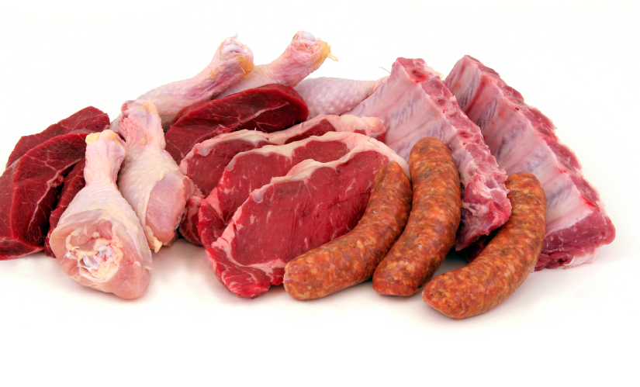
Focus: Meat and Fish
Provides high amounts of Protein
Can be high in fat

Slide 4
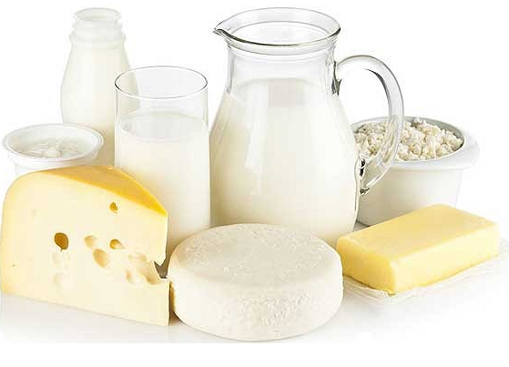
Dairy
Consume sufficient quantities of dairy
Most English people meet their calcium requirement
Strong bones and teeth
Lower risk of Osteoporosis

Slide 5
Breakfast
Usually served between 7:00 and 9:00 AM
Most days people eat foods like us, such as cereal or yogurt
In the winter some people eat porridge

Slide 6
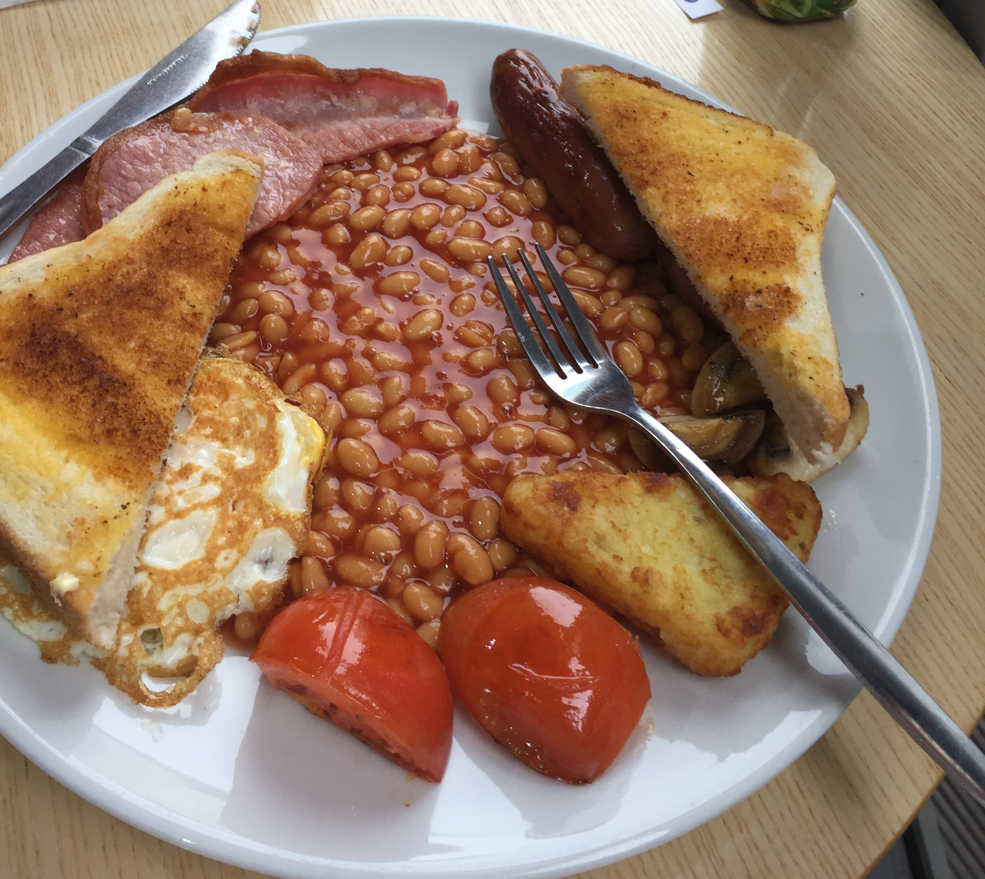
Full English Breakfast
Eggs
Sausage
Bacon (more like ham)
Baked Beans
Hash brown
Grilled tomatoes
Mushrooms
Black Pudding (blood sausage)
Toast

Slide 7
Lunch
Usually served between 12:00 and 2:00 PM
Meal Deals include a sandwich, drink, and bag of crisps at a discounted price
Sometimes referred to as dinner

Slide 8
Tea
Afternoon Tea is had between 3:00 and 5:00 PM
A time to catch up with family or friends on their day

Slide 9
Dinner
Usually served between 6:00 and 8:00 PM
Main meal served in the evening
Sometimes also referred to as “Tea”

Slide 10
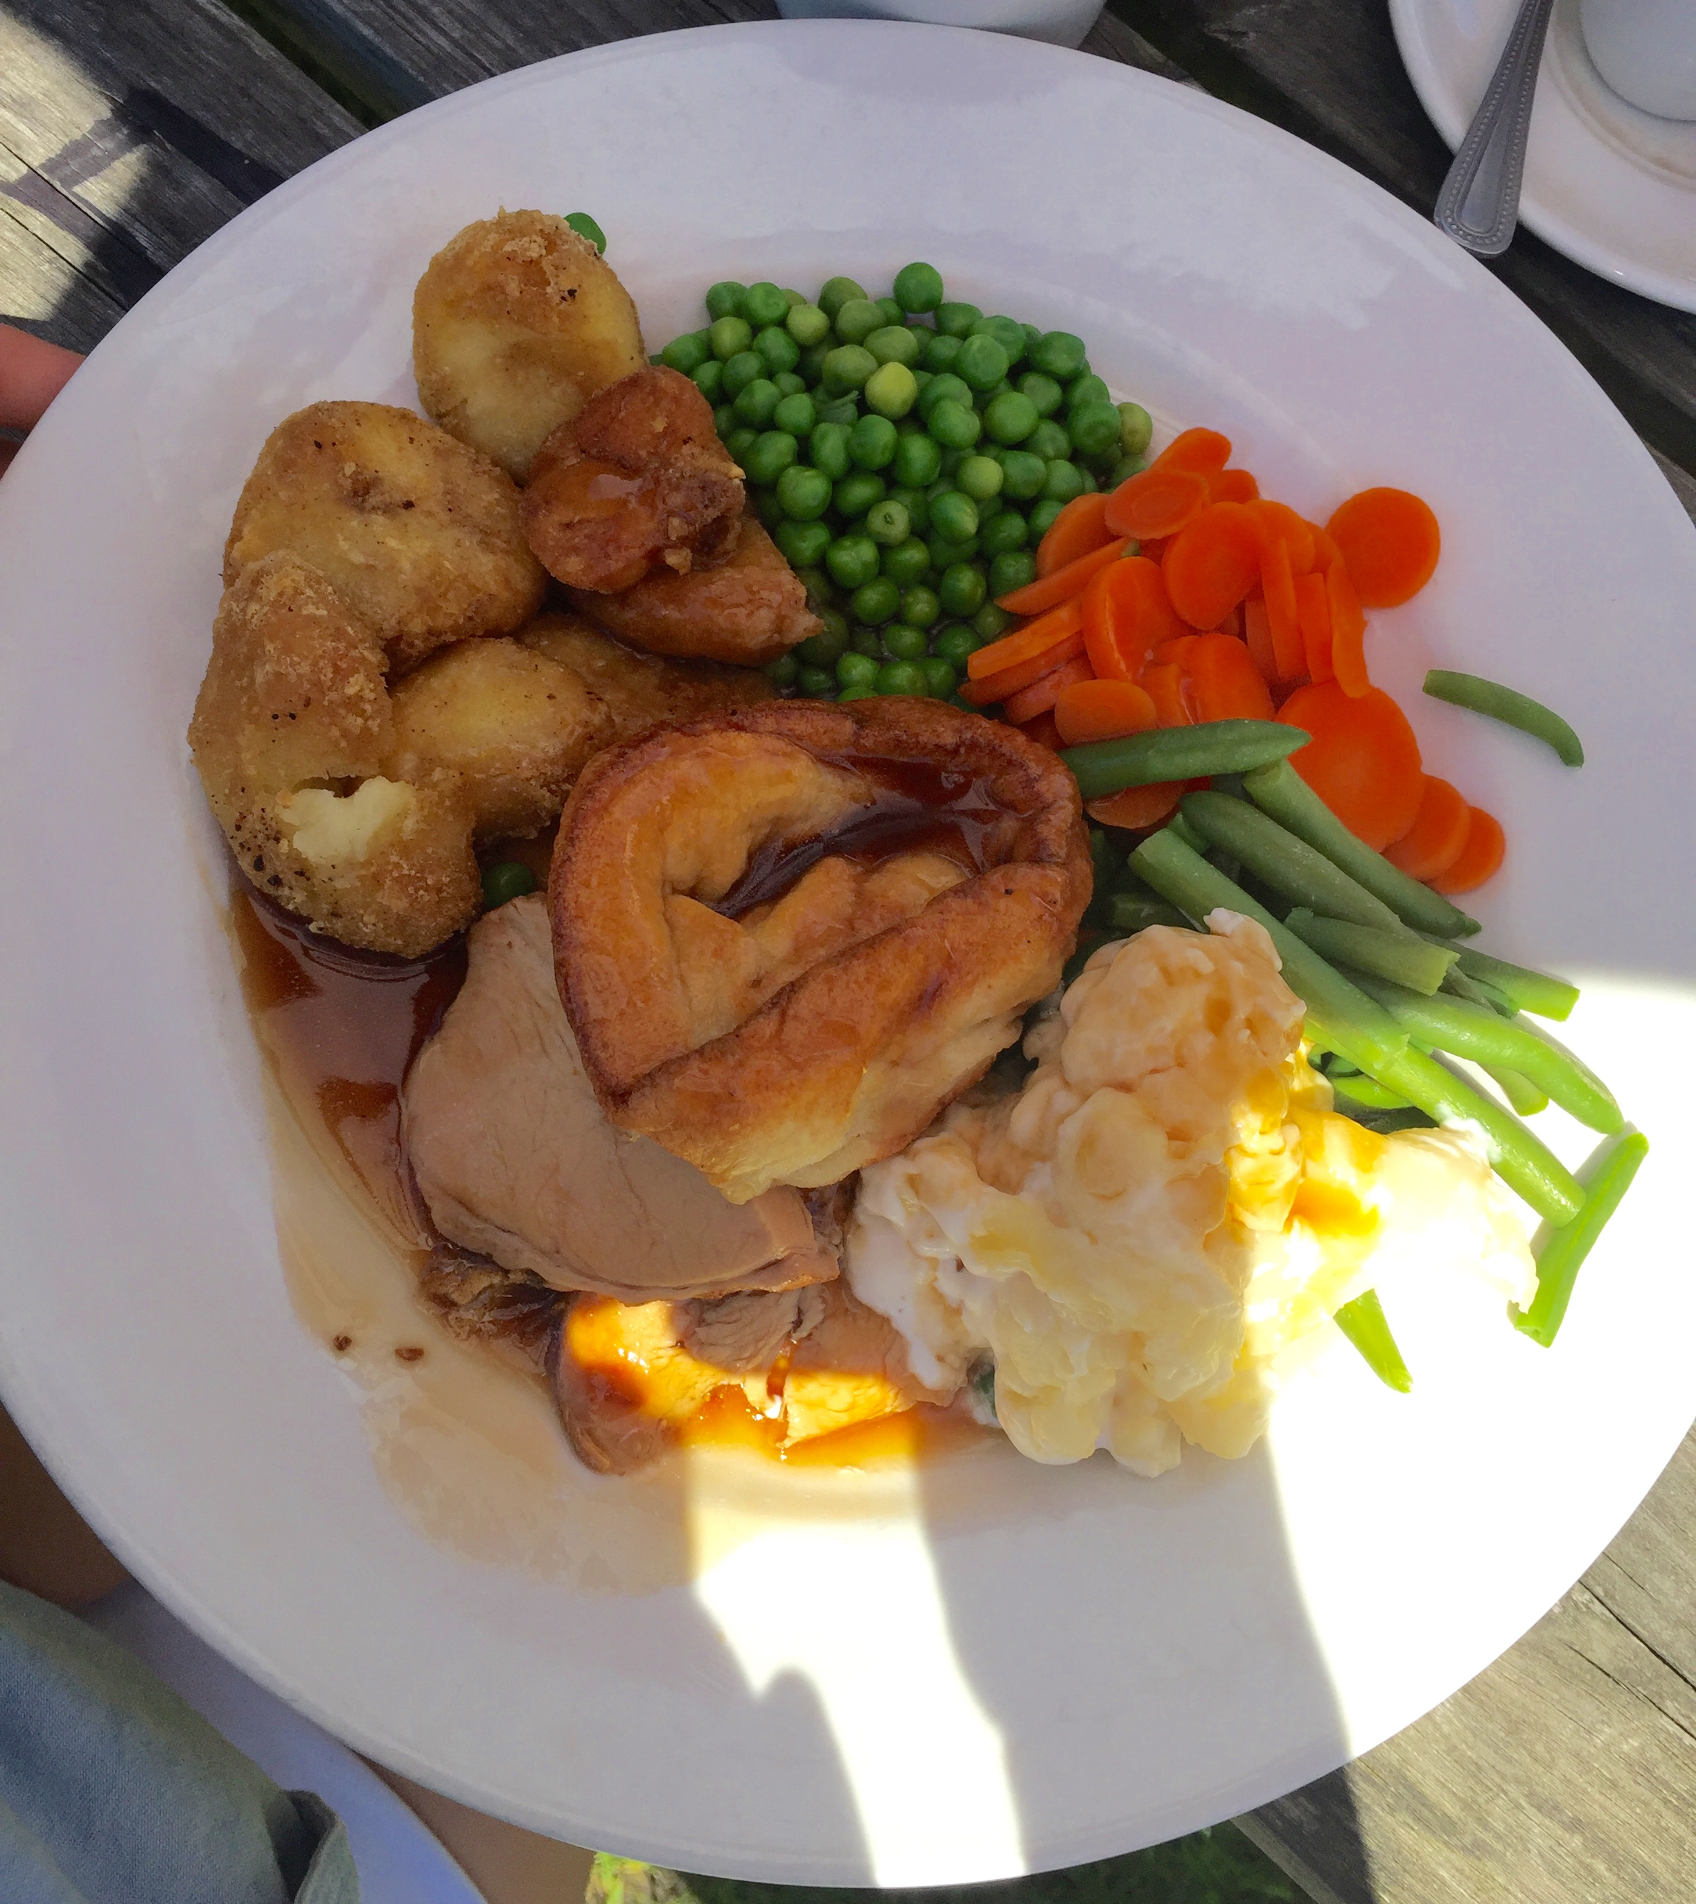
Sunday Roast
Oven Roasted Meat (usually chicken or turkey)
Potatoes
Two types of vegetables
Yorkshire pudding (flaky bread made of egg, flour, and milk)

Slide 11
Health
High in fat
Average English diet consumes 42% fat daily, according to the Vegetarian Society (Allen, 2015).
Normal recommendation is between 30-35% fats

Slide 12
CVD Risk
Higher consumption of fat, especially saturated fat
Higher occurrence of Heart disease than 12 of 15 European countries (Cespedes, 2015)

Slide 13
Randomized Control Trial
Control group: Traditional English diet along with butter-based spreads, palm-oil derived cooking oil, cookies, and refined breakfast cereal
Intervention group: Reductions in sodium, saturated fat, and added sugars
Findings: Overall improvement in diet quality in the intervention group could provide long-term benefits against cardiovascular disease risk

Slide 14
Exchange List
Meals and snacks | Starches | Fruits | Milk | Nonstarchy Vegetables | Meat and Meat Subst. | Fats
Breakfast Time: 8:00 AM | 2 | 1 | 1 | 2 | 2 | 1
Lunch Time: 12:00 PM | 2 | 1 | 0 | 2 | 1 | 1
Snack Time: 4:00 PM | 0 | 0 | 1 | 0 | 0 | 1
Dinner Time: 7:00 PM | 3 | 2 | 0 | 3 | 3 | 3

Slide 15
Breakfast
Breakfast | 1 | Egg (large) | fried | 1 medium fat protein, 1 fat exchange
 | 1 slice | Canadian bacon | grilled | 1 Lean protein
 | ½ cup | Tomato | grilled | 1 Non-starchy veg
 | 1 | Hashbroown | Baked | 1 Starch
 | 1/2 cup | Mushrooms | Sliced, cooked | 1 Non-starchy veg
 | 1/3 cup | Baked Beans | heated | 1 Starch
 | 1 cup | Skim milk |  | 1 fat-free milk
 | ½ cup | Blueberries |  | 1 Fruit

Slide 16
Lunch
Lunch | 2 Slices | Whole grain bread |  | 2 Starches
 | 1 oz. | Lean Deli Turkey |  | 1 Lean Protein
 | ½ cup | Broccoli | Steamed | 1 Non-starchy Vegetable
 | 1 T | Reduced fat Mayonnaise |  | 1 Fat
 | 1/2 cup | Cauliflower | Steamed | 1 non-starchy veg
 | 1 | Apple | Unpeeled | 1 fruit

Slide 17
Afternoon Tea
Snack | 1 cup | Coffee |  | 1 Free food
 | 1 cup | Whole- milk |  | 1 Milk + 1 Fat

Slide 18
Dinner
Dinner | ½ cup | Peas |  | 1 Starchy Veg
 | ½ | Medium Potato | Boiled | 1 Starchy Veg
 | ½ cup | Cauliflower | Cooked | 1 Non-starchy veg
 | ½ cup | Carrots | Cooked | 1 Non-starchy veg
 | ½ cup | Green Beans | Cooked | 1 Non-starchy veg
 | 3 oz. | Turkey | Roasted | 3 Medium fat- protein + 3 fat
 | ½ cup | Pears, canned |  | 1 Fruit
 | ¾ cup | Pineapple, fresh |  | 1 Fruit

Slide 19
References
Allen, J. (2015, August 03). Traditional English Diet. Retrieved August 02, 2016, from http://www.livestrong.com/article/282027-traditional-english-diet/
Buchdahl, E. (2014, February 11). What time is dinner? A guide to meals in the UK. Retrieved August 02, 2016, from http://www.educationuk.org/global/articles/guide-to-uk-meals/
Cespedes, E. M., & Hu, F. B. (2015, May 01). Dietary patterns: From nutritional epidemiologic analysis to national guidelines. American Journal of Clinical Nutrition, 101(5), 899-900. doi:10.3945/ajcn.115.110213

